Slide 1

Market Forecast
Source deemed reliable but not guaranteed. Source: MBS Highway ﻿

Slide 2

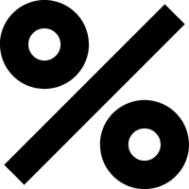

2021 Recap
Interest Rates
Forecast: Expected rates to rise beginning of year and recover into the fall
Actual: Rates did rise sharply through March, as anticipated. But recovered a bit earlier than we expected, gaining back most losses by late summer
Housing
Forecast: Strong demand and tight supply would push home prices up by high single-digit percentage
Actual: There was strong demand and tight supply, but Covid caused supply chain disruptions and labor shortages, which pushed real estate values even higher than our robust forecast

Slide 3
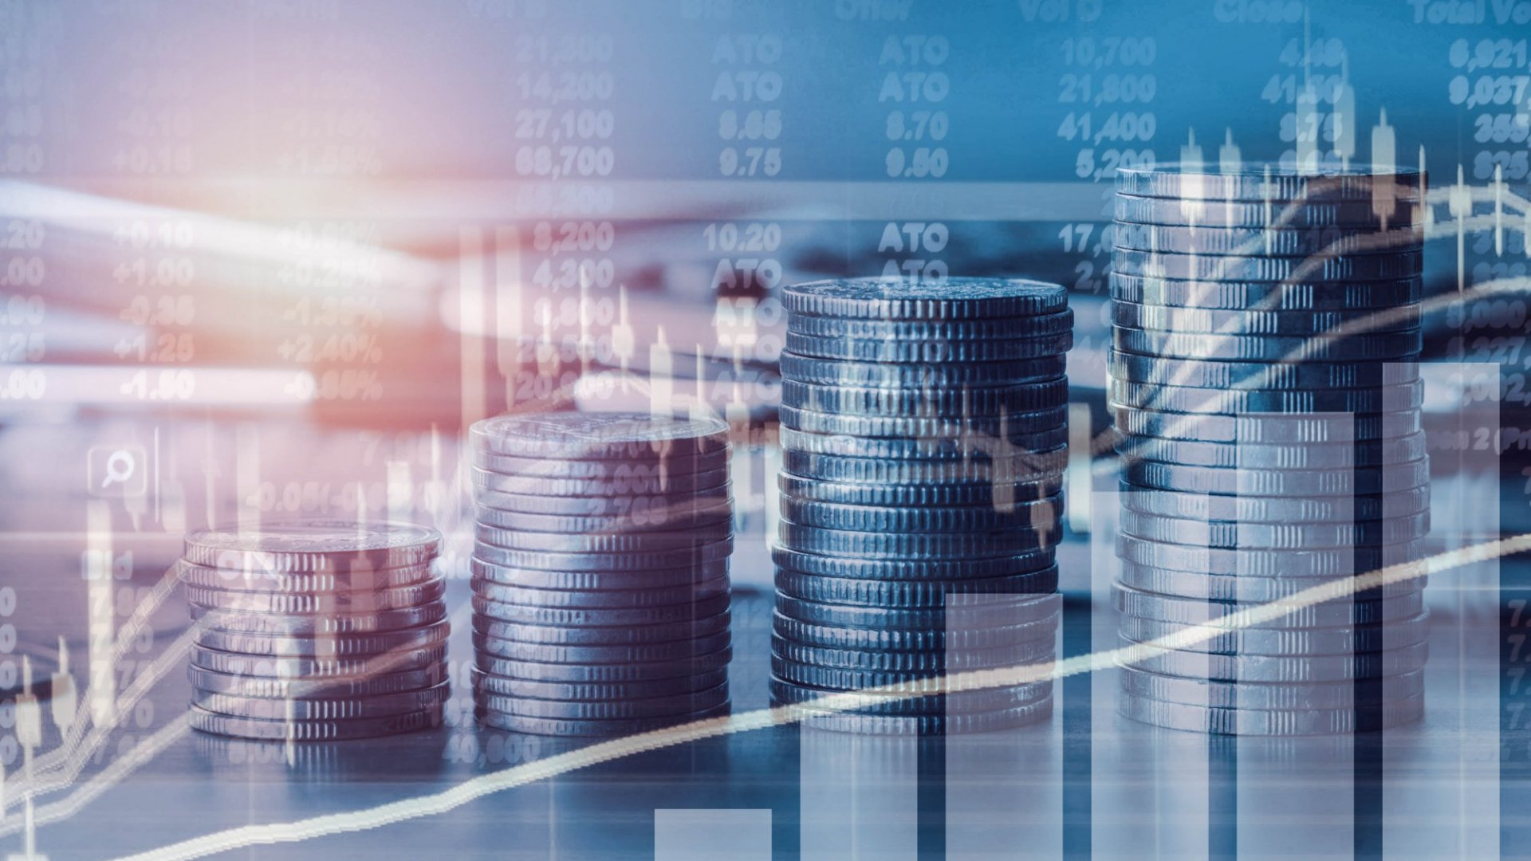
2022 Dynamics
The Fed will play a major role in 2022
Tapering, rate hikes, balance sheet runoff
Can impact equity markets, drive interest rates, impact housing, as well as jobs
Some Fed voting members rotate each year
2022 composition will be less accommodative than 2021
Fighting inflation is main focus – negative stock market reaction could cause Fed to lose resolve
Fed should have hiked sooner – mistakenly thought inflation was “transitory”
History can help us forecast how the Fed’s actions in 2022 will influence the markets

Slide 4

History – Arthur Burns
1970s – Burns was Fed Chair
Ignored inflation, which was rising rapidly
Insisted inflation would be “transitory” - sound familiar?
Year over year inflation ballooned from 7% in 1978 to 14% by time he left in 1980
Burns remained steadfast that inflation was “transient”
Higher inflation caused mortgage rates to rise from 12% to 18%

Slide 5
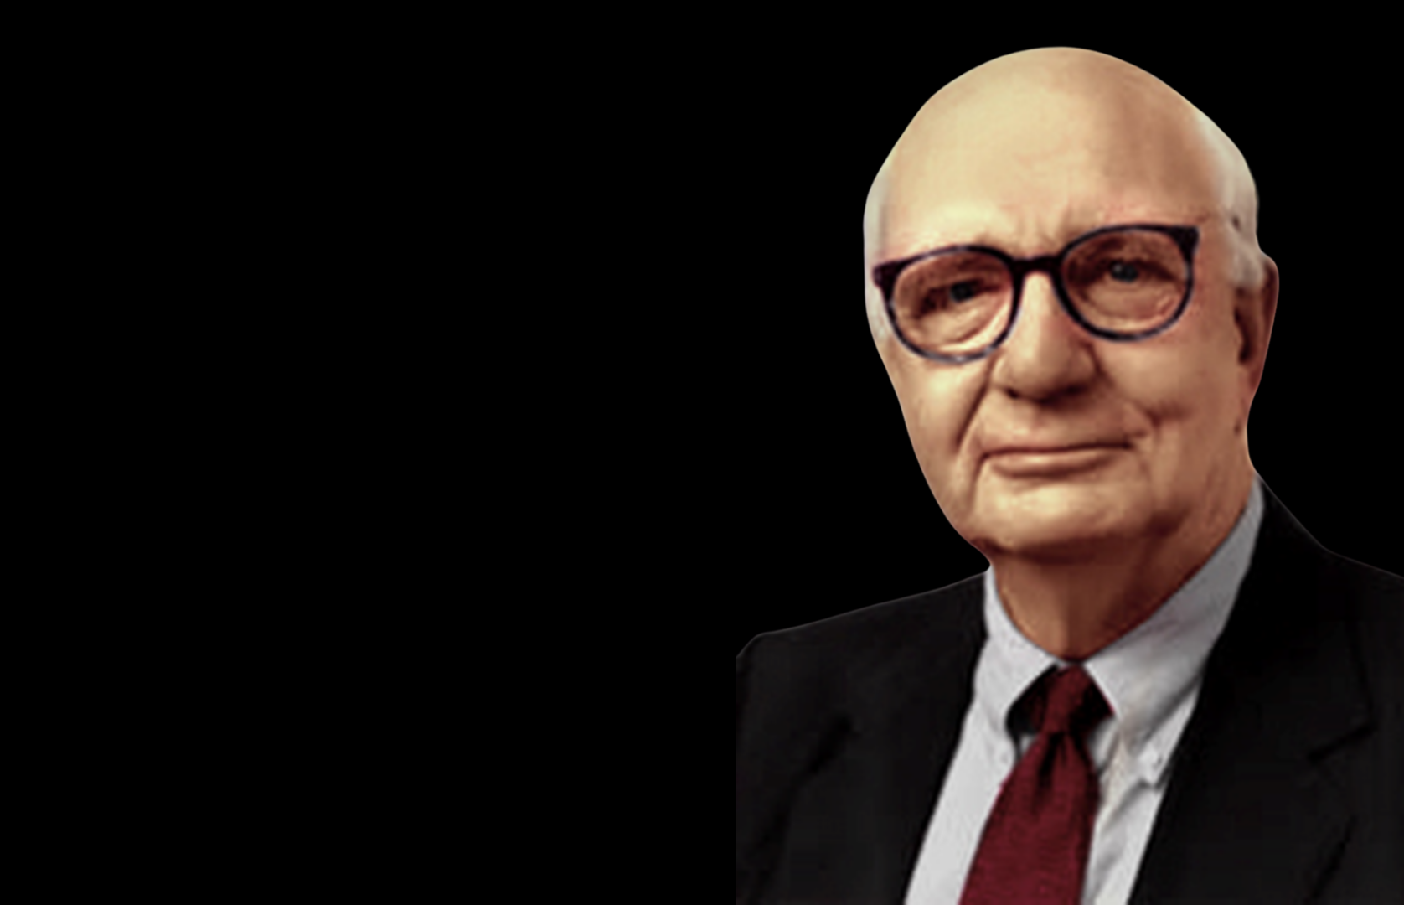
1980 Paul Volcker Fights Inflation
Hiked Federal Funds Rate from 11% to 20% in two years
Inflation dropped from 14% to below 5%
Because inflation dropped, mortgage rates sharply declined from 18% towards 12%
But there were consequences –
The S&P 500 sharply declined by 30% during this time
Tighter monetary policy pushed US into recession in 1982

Slide 6
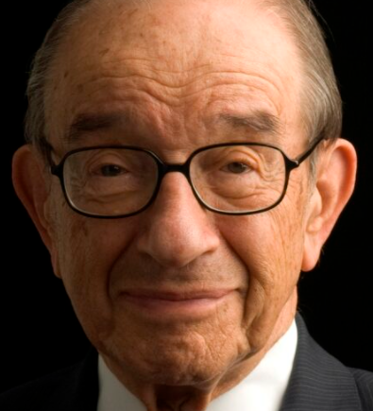
Alan Greenspan
Late 1990s – Inflation doubled from 1.75% to 3.5%
Higher inflation caused mortgage rates to rise from 7% to 8.5%
Unlike Burns, Greenspan took action mid 1999 and hiked Federal Funds Rate by 1.75% (matching rise in inflation) from 4.75% to 6.5% in a year
Inflation responded and dropped from 3.5% towards 1%
Mortgage rates dropped from 8.5% to 5.5%, sparking huge refi boom
But there were consequences –
S&P 500 fell by 50% from spring to fall of 2000
US entered a recession in 2001

Slide 7
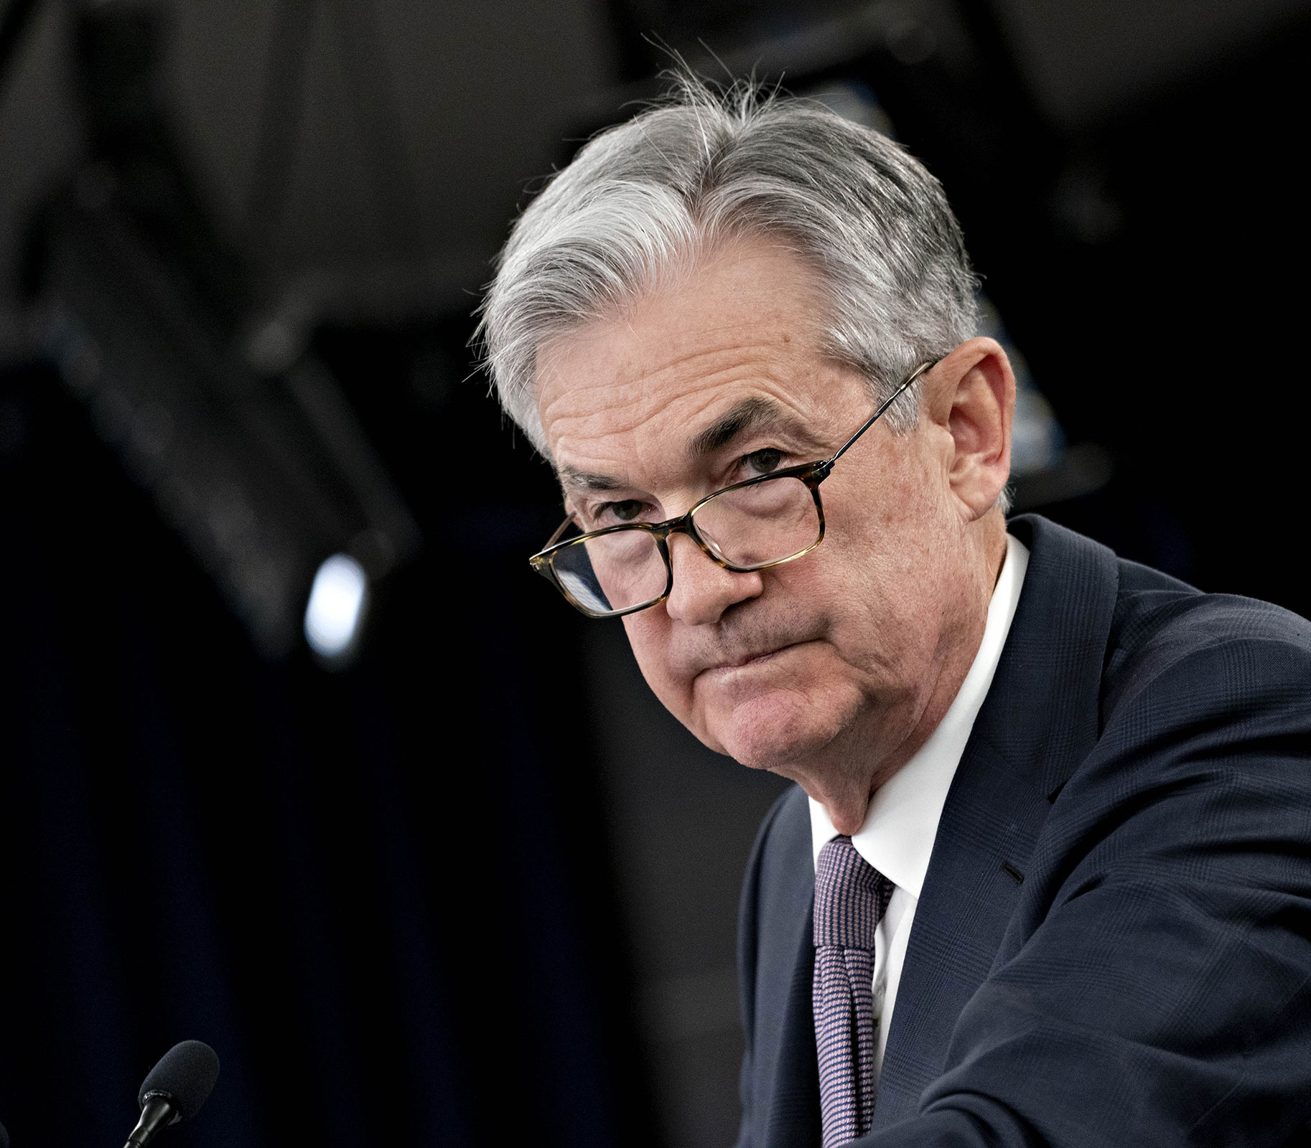
Today Under Jerome Powell
2021 inflation increased from 1.75% to 7%, Powell thought “transitory”
Higher inflation caused mortgage rates to rise from 2.5% to 3.375%
Fed is currently tapering their purchases of Mortgage Bonds and Treasuries – will not hike and reduce purchases at same time
Done tapering in March, likely to begin hiking in May
Fed targeting three rate hikes in 2022 and two or three more in 2023
Inflation and interest rates can still rise until Fed acts
If Fed can tame inflation, mortgage rates should drop, but may be from higher levels

Slide 8


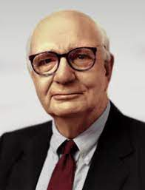
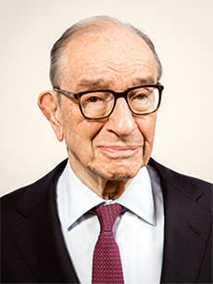
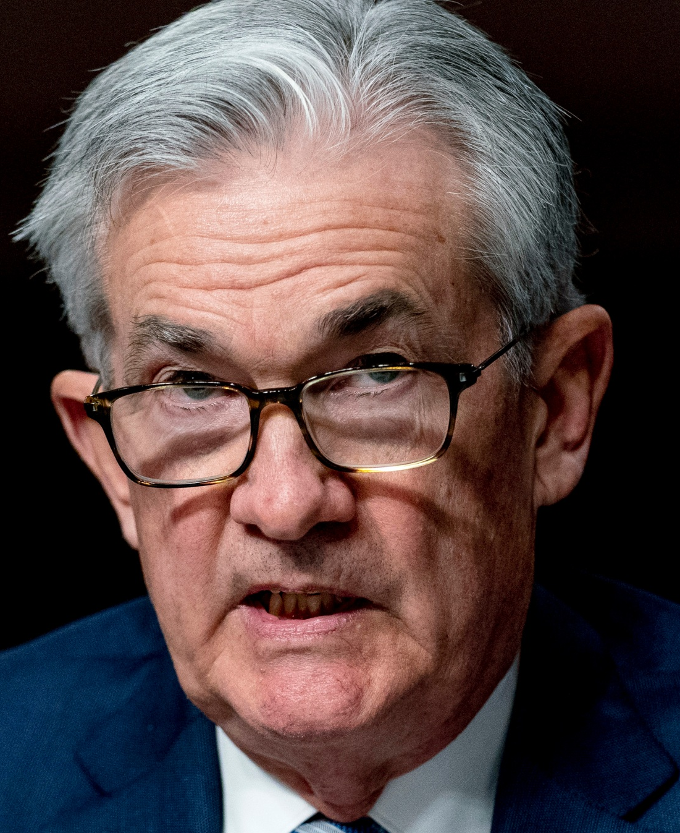
Recap...See a Pattern?
Fed Funds Rate
Inflation
Response
Mortgage Rate
Response
Fed Chair
Inflation
Mortgage Rates
Consequences
7% to 14%
12% to 18%
S&P down 30% Recession
11% to 20%
14% to 5%
18% to 12%
Burns/Volcker
S&P down 50% Recession
1.75% to 3.5%
7% to 8.5%
4.75% to 6.5%
3.5% to 1%
8.5% to 5.5%
Alan Greenspan
Stocks expensive
Economy slowing
Recession?
1.75% to 7%
2.5% to 3.375%
0% to 1%
in 2022
Should decline as inflation declines
Should drop
Jerome Powell

Slide 9

Wildcards
Covid plays major influence on monetary policy and supply chains
Major surprise in Covid could change outlook dramatically
Additional stimulus may fan flames of inflation
Would push Stock prices temporarily higher
Cause mortgage rates to rise further
Make Fed’s job of corralling inflation more difficult
Runoff of Fed’s Balance Sheet
First step – Fed to stop purchasing new Mortgage Bonds and Treasuries
Next step – Hiking Fed Funds Rate
Fed still buying $70B/month in Mortgage Bonds through reinvestments, keeping rates low
If/when Fed stops reinvestments, mortgage rates could move higher than previously thought

Slide 10
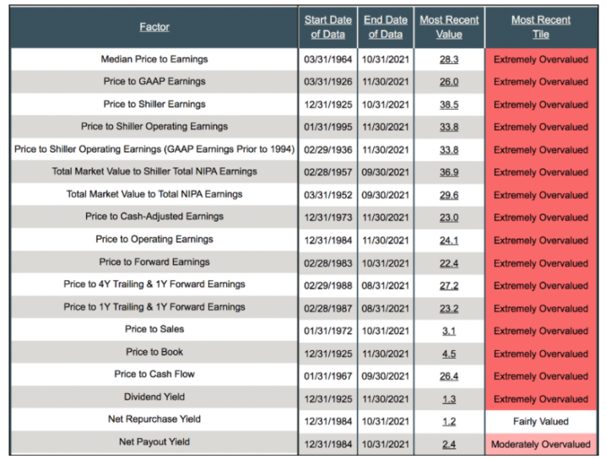
Stock Market Forecast
Stocks are expensive and price to earnings multiples are high
Rate hikes could cause P/E multiple contraction, resulting in lower stock prices, as seen in the past
Forecast: ~10% decline in the major indices in 2022

Slide 11
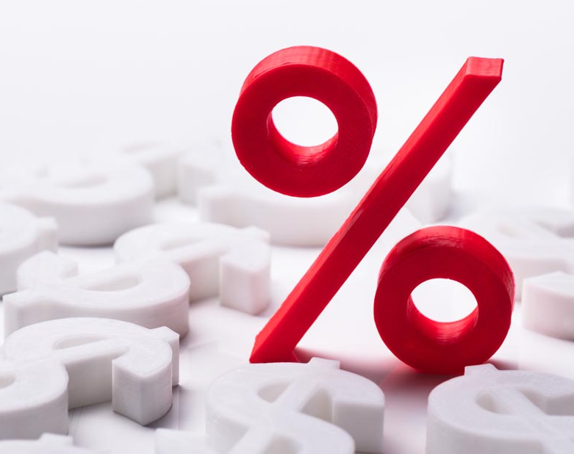
Interest Rate Forecast
We anticipate mortgage rates to rise along with inflation during first part of the year towards 3.75%
With Fed action, softer stock market, and slowing economic conditions, interest rates should head lower in second part of year towards 3%
Forecast – Rates rise towards 3.75% first half of year, decline towards 3% second half as Fed hikes rates
Strategically, this sets up for a bias of less upfront fees because of a refinance opportunity ahead

Slide 12

Housing Forecast
Housing will remain strong in 2022, but not as strong as 2021
Demand may be slightly softer due to a rise in interest rates, but still robust
Supply will increase, but remain tight
Tight labor, supply chain disruptions, and semiconductor shortages will all play a role
Rents will continue to rise
Increases will remain above 5%, pushing many people to see the benefit in buying
Forecast – Mid to high single-digit appreciation, still providing a great wealth creation opportunity
Source deemed reliable but not guaranteed. Source: MBS Highway ﻿

